Slide 1

Exporting Food Products to the United States
Dr. Gleyn Bledsoe
Gleyn@Live.com
This presentation was made possible with the support of the American People through the U.S. Agency for International Development (USAID).
The contents of this document are the sole responsibility of the authors and do not necessarily reflect the views of USAID or the US Government.

Slide 2

HOW TO EXPORT TO THE US: GENERAL ASPECTS
Domestic and imported foods must follow the same legal requirements in the U.S.
Exporters must provide food that is safe, be free of microbial contamination, chemicals or filth and manufactured under Current Good Manufacturing Practices
Must be labeled in conformity with US regulation
Must follow US legal regulations (laws of country of origin do not always apply, except in the case of food from New Zealand and Canada). Customer specifications are important and generally include all federal regulations plus purchasing company’s additional requirements.
FDA does not certify or previously approve food exporters, their products, labeling or cargos. (Voluntary Qualified Importer Program fee program that speeds up imports)
FDA may detain an imported consignment if they suspect it is not in accordance with the requirements of the US

Slide 3



US FOOD REGULATORY SYSTEM
Food and Drug Administration
Implementation of food safety laws to prevent food safety problems in the US
population. FDA regulates all food products with the exception of pork, beef, poultry
and processed eggs. (which come under USDA responsibility).
U.S. Department of Agriculture
  APHIS – protect against animal diseases and plant pests
  FAS – promote US agricultural products in international market
  FSIS – ensure the safety of meat, poultry and processed eggs
  Environmental Protection Agency (EPA):
Registers all pesticides for sale within the US. Also, establishes tolerances for
pesticides in food for humans and animals.
* There are 15 federal agencies involved in regulating importation of food products

Slide 4
NECESSARY STEPS TO EXPORT TO THE UNITED STATES
Registration of Food Facility
Prior Notice for shipments (On line Prior Notice access
www.access.fda.gov)
Have a Food Safety Modernization Act Compliant Food Safety Plan
Ensure that the product is safe, wholesome, well- packaged and properly labeled

Slide 5
FACILITY REGISTRATION
Each site must be separately registered. If a company has six different facilities where a product is processed, it must register each of these facilities.
For foods consumed by humans and animals within the US.
Registration is free of cost and must state an agent that resides in the US
Registration must be renewed every two years!
Who must register?
  Manufacturers or those who process
  Packers
  Storage facility
Register on line: http://www.access.fda.gov
Notes:
5

Slide 6
Food Safety Modernization Act
Risk based program that is based upon earlier HACCP concepts
  Food Processors are to have a “Preventive Control Qualified Individual” (PCQI) to develop food safety plan and review processing records.
  Emphasizes employee training and written records
Formalized in company’s Food Safety Plan
Phased in requirement predicated upon company size (this can be misleading and smaller companies should promptly implement this program if they are to sell to larger companies)
Certification Training Courses

Slide 7
Food Safety Modernization Act cont’d
Very dependent upon written records
Training oriented – All employees at a facility must be qualified for their job and their training documented
Record must be retrievable within 24 hours of notice from FDA
Records need not be in English, but must be translated upon request within a reasonable time.
Build upon your existing food safety program

Slide 8
Relevant Training Courses
Preventive Controls for Human Foods
Preventive Controls for Animal Foods
Foreign Suppliers Verification Program
Sanitary Transportation of Food
Seafood HACCP
Juice HACCP
Principles of Thermal Process Control (LACF/AC FOODS)
Produce Safety
Sprout Safety (Under development)

Slide 9
Food Safety Plan Overview
A written Food Safety Plan, specific to the facility, is required to include a hazard analysis
When hazards requiring a preventive control are identified, the following are required, as appropriate:
  Preventive controls
    Process, food allergen, sanitation, supply-chain and others determined through the hazard analysis process
    A recall plan
  Food Defense Plan
  Implementation procedures
    E.g., validation studies and monitoring, corrective actions and verification procedures
The format is flexible

Slide 10
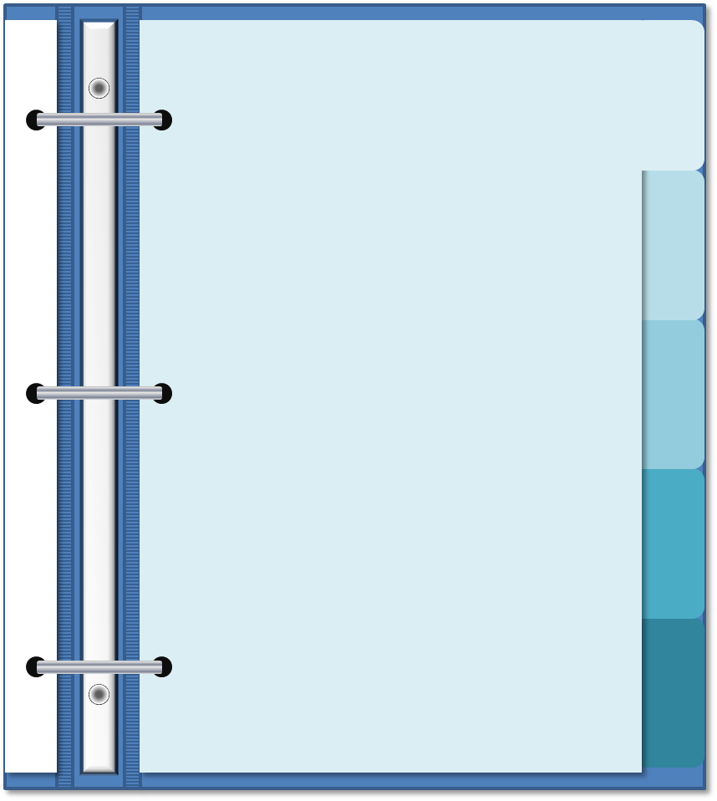
Main Organizational Sections
Background Information
Background information - optional
Hazard analysis
Preventive controls
Recall plan
Food Defense Plan
Implementation procedures
Hazard Analysis
Preventive Controls
Recall Plan
Implementation Procedures
Notes:
Image graphics are found in “Notebook Image Graphics” file

Slide 11


LACF / AC
Low- Acid Canned Foods LACF :
  Food with a pH of 4.6 or higher and a water activity (aW) > 0.85
  Does not include alcoholic beverages
Acidified foods - foods with a normal pH of 4.6 or less (not included in LACF)
Primary Objective is to control Clostridium botulinum - a type of bacteria that occurs in food kept in poor conditions. Botulinum toxin (produced by the bacteria) grows in acidic and anaerobic environments, and can cause a fatal paralysis in humans.
The LACF program helps to prevent the production of this toxin
Training Requirement: Basic Certificate in Principles of Thermal Process Control

Slide 12
REQUIREMENTS FOR LACF/AC FOODS
Obtain an additional registry with FDA or FCE (Food Canning Establishment)
Submit information (*Process Schedule) as to how the product was processed Submission Identifier" (SID)
Apply the process to the foods
Keep required records
  * Process Authority develops a process schedule for every product and individual container size/type
FDA Link for LACF http://www.fda.gov/Food/GuidanceRegulation/GuidanceDocumentsRegulatoryInformation/AcidifiedLACF/default.htm

Slide 13

HACCP FOR SEAFOOD
http://www.fda.gov/food/guidanceregulation/haccp/ucm2006764.htm

Slide 14
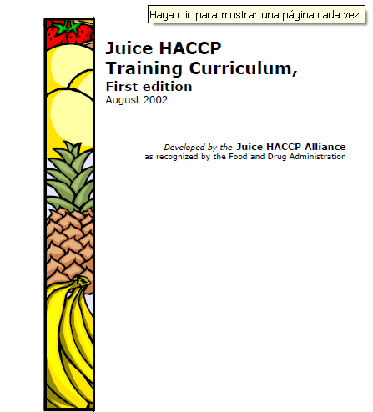
HACCP FOR JUICE
http://www.fda.gov/Food/GuidanceRegulation/GuidanceDocumentsRegulatoryInformation/Juice/ucm072586.htm

Slide 15
DAIRY PRODUCTS
Additional Requirements
Dairy products must be pasteurized
Milk and Cream may be exported with a special permit (FDA form-1993)
Dairy produce Grade A may only be exported to the US if the producer has been certified by a state or authorized as a processor that complies with the requirements of the Pasteurized Milk Ordinance (PMO).
The list of the authorized processors
  https://www.accessdata.fda.gov/scripts/ims/mkex/ims/imssl-fr.cfm

Slide 16


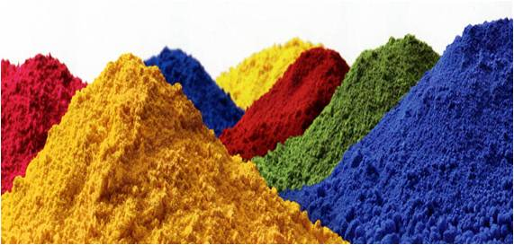
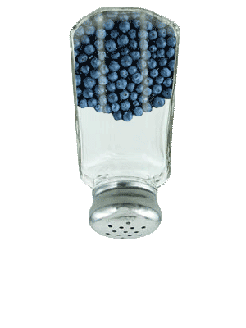
How to Know if an additive is permitted by the FDA ?
Everything Added to Food in the United States (EAFUS)
This information is generated from a database maintained by the U.S. Food and Drug Administration (FDA) Center for Food Safety and Applied Nutrition (CFSAN) under an ongoing program known as the Priority-based Assessment of Food Additives (PAFA). PAFA contains administrative, chemical and toxicological information on over 2000 substances directly added to food, including substances regulated by the U.S. Food and Drug Administration (FDA) as direct, "secondary" direct, and color additives, and Generally Recognized As Safe (GRAS) and prior-sanctioned substances
http://www.accessdata.fda.gov/scripts/fcn/fcnNavigation.cfm?rpt=eafusListing

Slide 17
Labeling
Food Label is a panel found on a package of food which contains a variety of information about the nutritional value of the food item.
Information standard on most food labels,
  serving size,
  number of calories,
  grams of fat,
  included nutrients,
  list of ingredients
Allergen notice
Other relevant information i.e. Refrigerate after opening

Slide 18
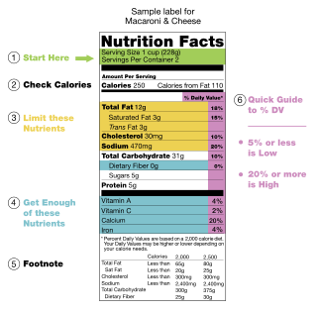
General Requirements
Label in English
  Multi-lingual is accepted if all the information is in both languages
New requirements as of 2018
Ingredients approved by the FDA and declared with the common name and in descending order based on its weight.
FDA Food Labeling Guide:
http://www.fda.gov/Food/GuidanceRegulation/GuidanceDocumentsRegulatoryInformation/LabelingNutrition/.htm

Slide 19
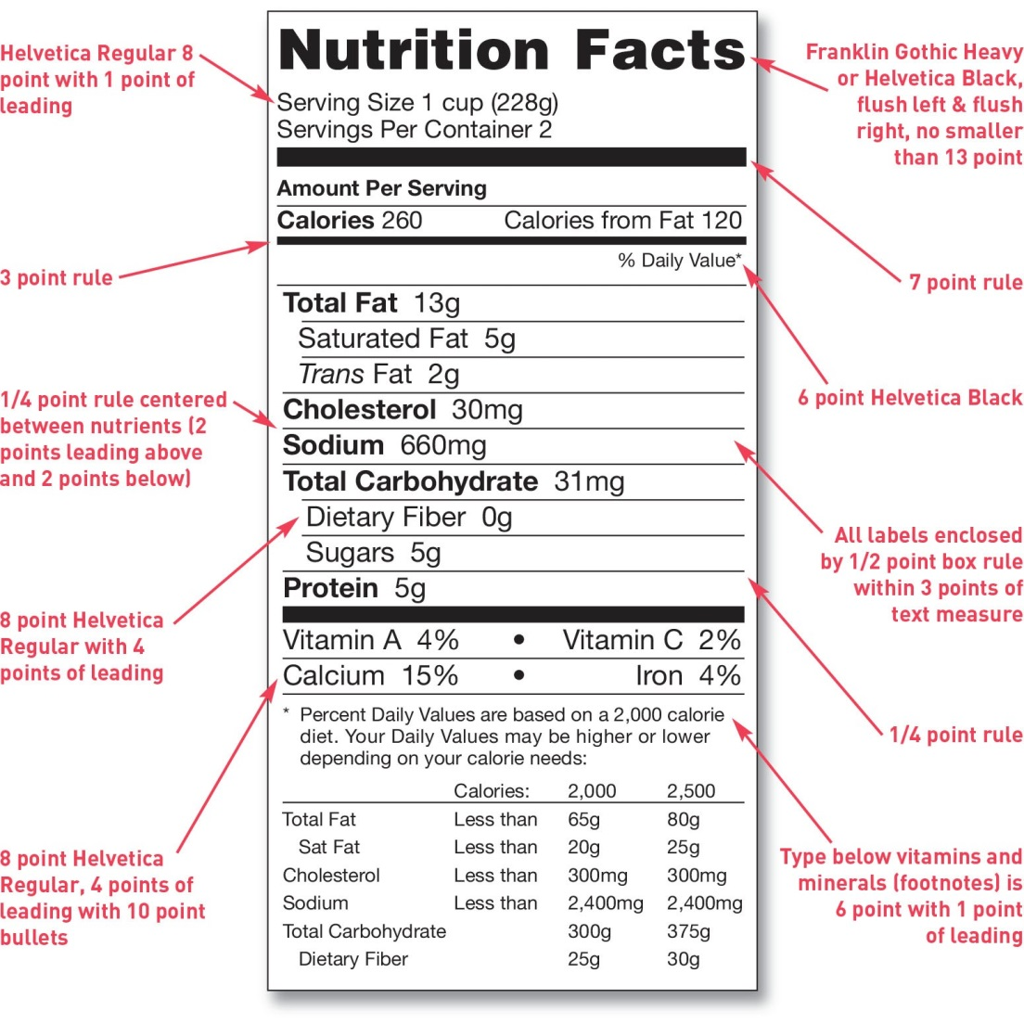
Graphic of Nutrition Facts used by FDA

Slide 20

ALLERGENS
Responsible for 60% of product recalls in the USA
Nuts
Wheat
Peanuts
Milk
Eggs
Fish
Seafood and Shellfish
Soybean

Slide 21
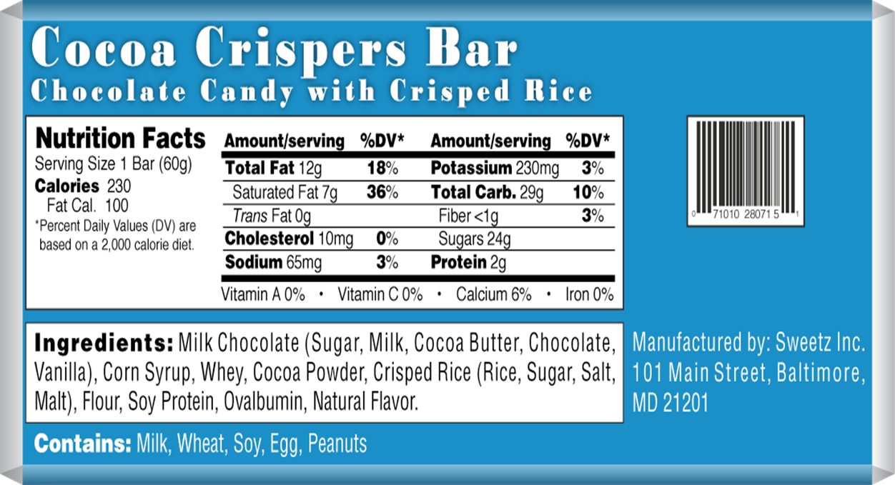
Two options to declare allergens
Within the list of ingredients
Common name Followed by the name in parentheses of allergen source
Eg.: Ingredients: ... whey (milk)
In a separate summary
In a separate summary Immediately following list of ingredients in a size not smaller than the ingredients
Contains: milk

Slide 22
Summary
Domestic and imported foods must follow the same legal requirements in the U.S.
Exporters must provide food that is safe
Packaging/Containers must be labeled in conformity to US regulation
FDA does not certify or previously approve food exporters, their products, labeling or cargos. (Voluntary Qualified Importer Program fee program that speeds up imports)
FDA may detain an imported consignment if it is not in accordance with the requirements of the US
FSMA import compliance places responsibility on “importers who in turn rely heavily upon 3rd Party Auditors
Training and appropriate records are critical .

Slide 23
Summary
Become FSMA qualified with a good comprehensive Food Safety Plan
Use this in your marketing efforts
Be knowledgeable of the FSVP requirements of your customer/importer and provide the data they need
Be pro-active!!

Slide 24
For any inquiries or assistance:
Address: Immeuble Solaris, Rue du Lac d’Annecy,
Les berges du Lac1053, Tunis.
Tel : (+216) 71 86 23 87
Fax : (+216) 71 86 23 78
Mail : brcp-tunisia@pragmacorp.com
Website : www.brcp.tn

